Slide 1
UWE Bristol Advanced control and dynamics UFME7F-15-M
Tutorial 4
1 Introduction to control systems
2 Specify control system performance
Notes:
Welcome

Slide 2
General application --- control in life and work
Target = f (existing entity, extra effort)
-
Targeted
output
Real
output
Controller
Extra effort
Plant
Existing entity
Feedback

Slide 3
Simple example (closed loop and dynamic)
To turn this into an automatic control system some means of responding to actual temperature is required. function blocks, arrows and connection
Desired
temperature
+
Actual room temperature
Heater
Room
-
measurement
Feedback
Comparison or error measurement
What we do with the heater depends on temperature error

Slide 4
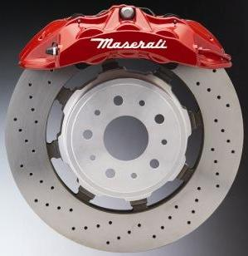
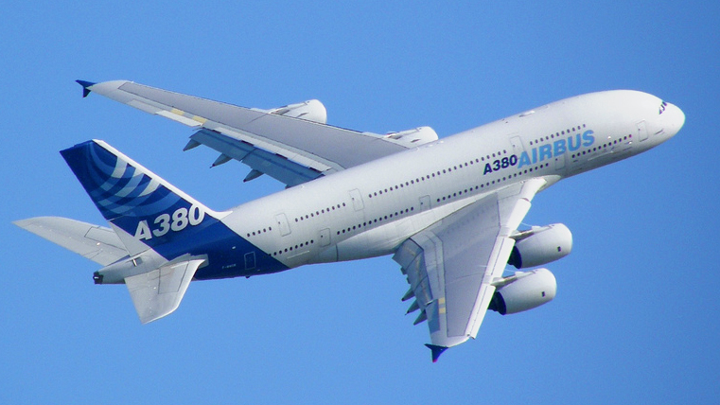
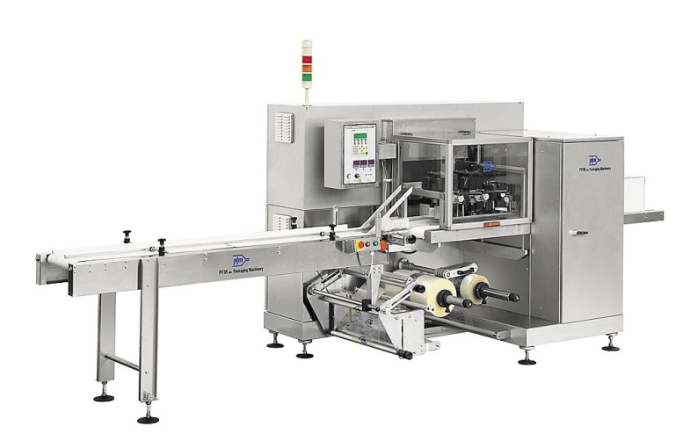
Some Examples
Control systems are required in complex machines, devices
Aircraft control systems
Robotic systems
Anti-lock braking systems
Manufacturing processes

Slide 5
Examples
Inverted Pendulum, etc.
Demo
Videos
http://tinyurl.com/uwetriple
http://tinyurl.com/uweballrobot
http://tinyurl.com/uwebigdog
http://tinyurl.com/uwekestrel

Slide 6
Specification of 2nd order systems for controller design with ζ and ωn
Let the closed control system behave like a second order system
Determine ζ and ω_{n} from requested/specified performance

Slide 7
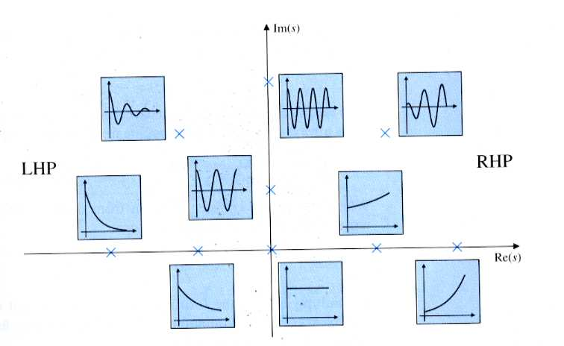
Response/pole location on the “s” plane
Stable
Unstable
High frequency oscillation
Low frequency oscillation
fast
slow
slow
fast

Slide 8
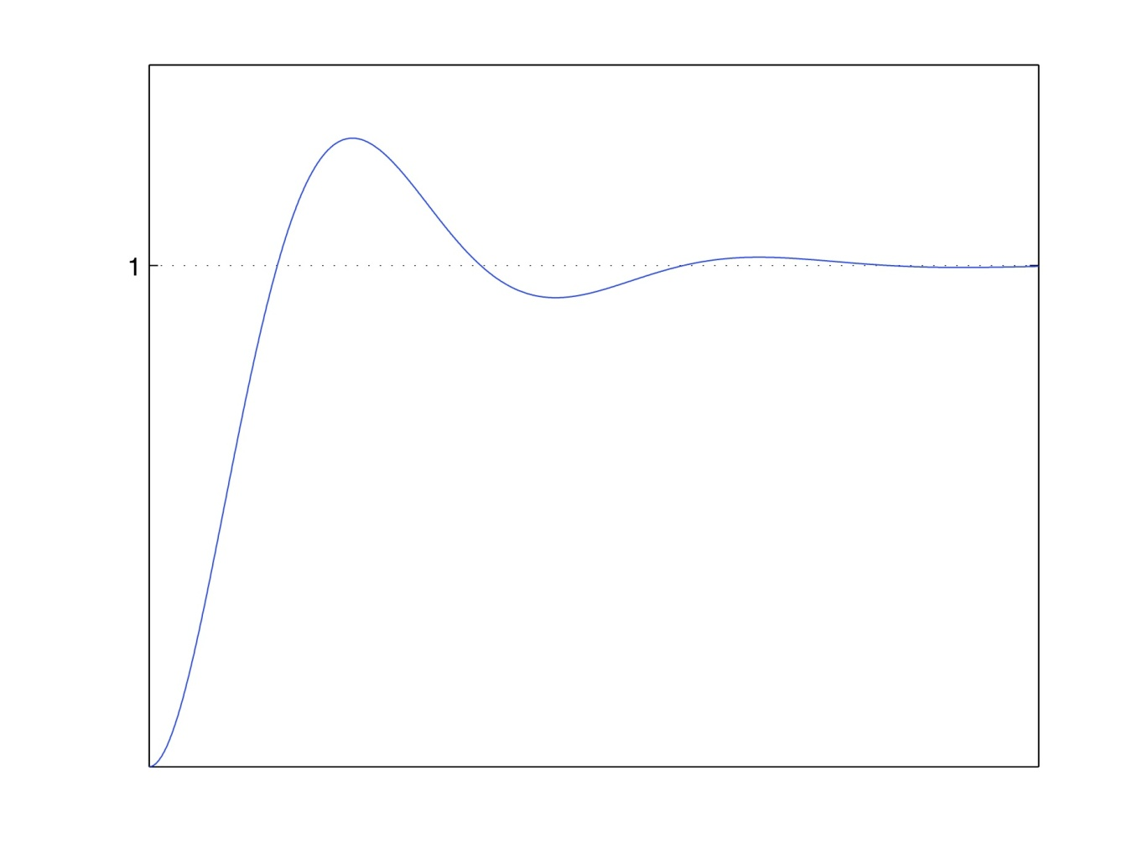
Second order step response
Performance Criteria: all linked with ζ and ω_{n}
Rise time, t_{r}
Time to first reach steady state value (for underdamped systems)
Time to go from 10% to 90% amplitude for overdamped systems
Peak time, t_{p}
Time to initial overshoot
Peak overshoot, y(t_{p}) –y_{ss}
Initial overshoot, above steady state value (usually expressed as %)
Settling time, t_{s}
Time for response to reach and remain in specified ratio (±5% in this case)
Number of oscillations to t_{s}
c(t)
c(t_{p}) –c_{ss}
c_{ss}
95%
5% settling time
0
t_{r}
t_{p}
t_{s}
Time

Slide 9
Rise time:
Time to peak:
c(t)
0
Time

Slide 10
Settling time
Peak overshoot ( is a percentage value)
c(t)
0
Time

Slide 11
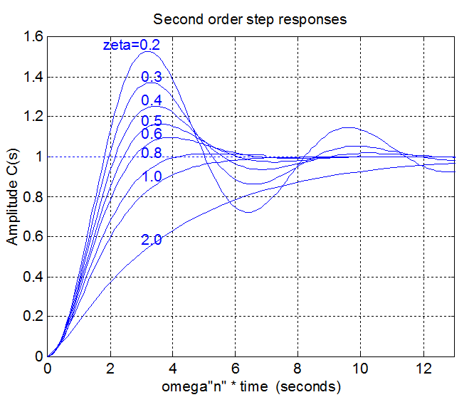
Standard (normalised) step response

Slide 12
First order: Unit step
We can use equation to estimate response
time | Output
0 | 0
τ | 63.2%
3τ | 95%
5τ | 99%
10τ | 99.9%

Slide 13
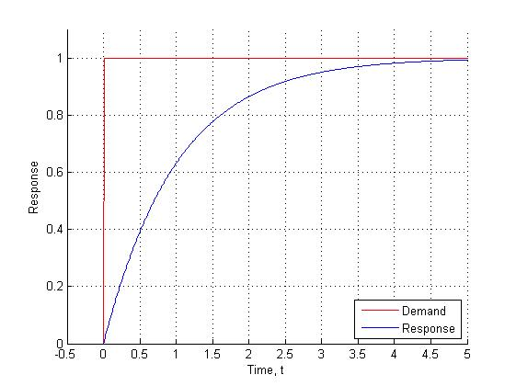
Example: unit step
Unit Step
95%
63.2%

Slide 14
Any questions?

